Slide 1
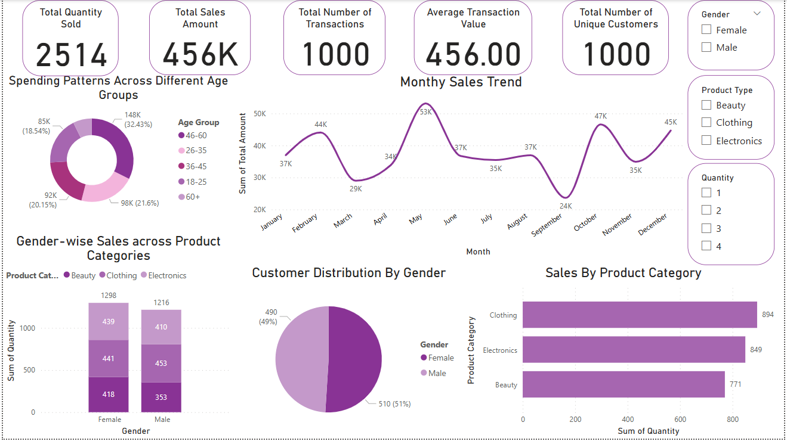
Retail sales dashboard summary
By S Lakshmi priyanka

Slide 2
Dashboard Objective and purpose
This Power BI dashboard was created to provide a clear and concise overview of retail transaction performance based on available customer and sales data. It helps stakeholders understand sales behaviour, demographic trends, and product preferences using interactive visualizations.
Key Objectives:
Analyze total sales performance over time using transaction data.
Identify top-performing product categories based on revenue.
Understand customer demographics (age and gender) and how they relate to sales.
Visualize the distribution of purchases across different age groups and genders.
Enable interactive filtering using slicers for product categories, gender, and quantity to gain deeper insights.

Slide 3
Dataset Overview
The dashboard uses a structured retail dataset containing customer and transaction-level data. It allows for a breakdown of sales performance by demographic and product attributes.
Key columns used:
Transaction ID: A unique identifier for each transaction, allowing tracking and reference.
Date: The date when the transaction occurred, providing insights into sales trends over time.
Customer ID: A unique identifier for each customer, enabling customer-centric analysis.
Gender: The gender of the customer (Male/Female), offering insights into gender-based purchasing patterns.
Age: The age of the customer, facilitating segmentation and exploration of age-related influences.
Product Category: The category of the purchased product (e.g., Electronics, Clothing, Beauty), helping understand product preferences.
Quantity: The number of units of the product purchased, contributing to insights on purchase volumes.
Price per Unit: The price of one unit of the product, aiding in calculations related to total spending.
Total Amount: The total monetary value of the transaction, showcasing the financial impact of each purchase.

Slide 4
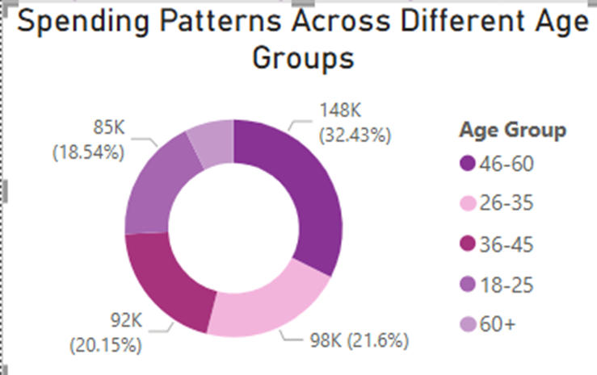
Spending Patterns Across Different Age Groups (Donut Chart)
Insights:
The 46-60 age group is the highest spender, contributing 32.43% of total sales (₹148K).
The 18-25 and 26-35 age groups are also strong contributors, with 21.6% (₹98K) and 20.15% (₹92K) respectively.
The 36-45 age group accounts for 18.54% (₹85K), which is slightly lower than the younger groups.
The 60+ age group shows minimal or no visible contribution (either very low or negligible in this dataset).
Interpretation: Middle-aged customers (especially 46-60) are the primary revenue drivers. Marketing strategies can be tailored to further engage this group, while youth (18–35) also remain important for targeted campaigns.

Slide 5
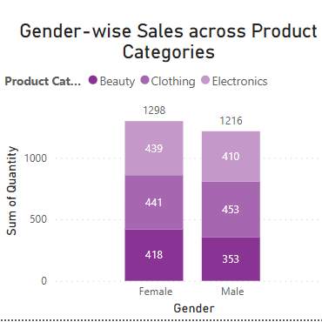
Gender-wise Sales across Product Categories (Stacked Column Chart)
Insights:
Females have made slightly more purchases overall (1298 items) compared to males (1216 items).
For both genders, Beauty and Clothing are strong product categories.
Interpretation: Women are the dominant customer base for Beauty and Electronics, while Clothing appeals almost equally to both genders. Product promotions and category-specific campaigns can be optimized accordingly.

Slide 6
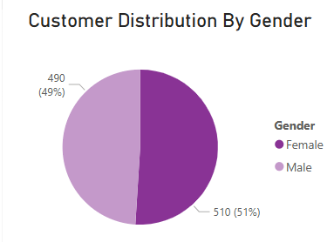
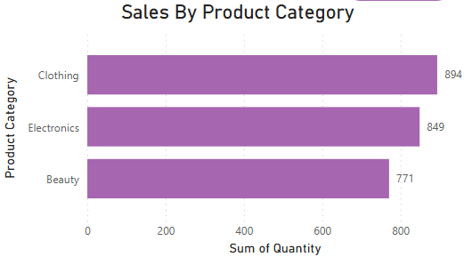
Insights:
The customer base is almost evenly split between genders.
Females represent 51% (510 customers) of the total customer base.
Males represent 49% (490 customers).
Interpretation: There is no significant gender skew in the customer population. Marketing efforts can be equally targeted towards both males and females.
Insights:
Clothing is the best-selling category with 894 units sold.
Electronics follow closely with 849 units sold.
Beauty products are slightly lower at 771 units sold.
Interpretation: Clothing drives the highest volume of sales, making it a critical category for promotions and inventory management. Electronics and Beauty also perform well, suggesting opportunities for cross-category marketing.

Slide 7
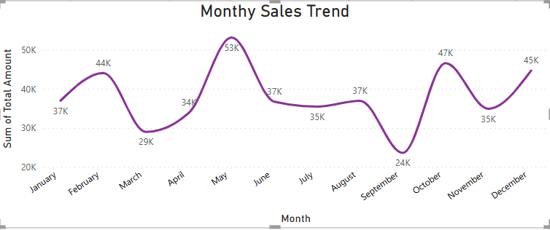
Monthly Sales Trend
Insights:
May recorded the highest sales at ₹53K, indicating a major sales peak.
October also showed a strong spike with ₹47K in sales, possibly due to festive or promotional seasons.
September had the lowest sales of the year at ₹24K, suggesting a significant dip.
February (₹44K) and December (₹45K) also performed relatively well compared to other months.
Sales show noticeable fluctuations month-on-month, with alternating peaks and dips throughout the year.
Interpretation: There are strong seasonal trends in sales. Special focus should be placed on maximizing sales during high-performing months (May, October, December) and investigating causes of low performance in months like September and April to strategize improvements.

Slide 9
Thank You

